Slide 1

Zeig Software Basic with Secured Door Enhancement
Built In The Cloud

Slide 2

Employee management
Your app allows you to easily manage employees with a friendly front end interface that stores all information in a secure Amazon Web Services back end cloud database.

Slide 3
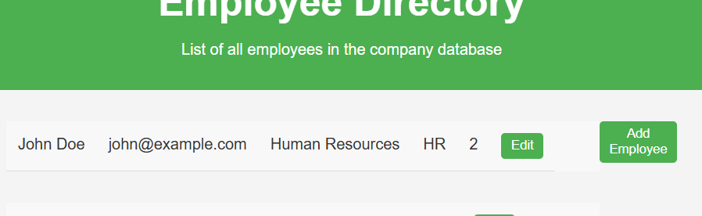
Product Screenshot
Easy to Use
Easy to Understand

Slide 4

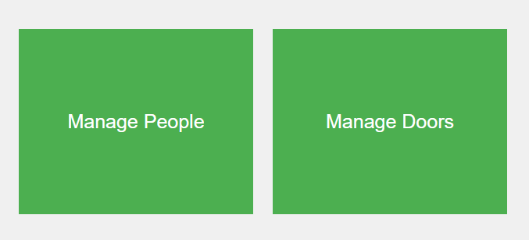
Building Security
Doors secured by Level
Each employee is assigned a security Level and a security Group. High Priority Levels have access to more Groups.
Doors secured by Group
Door Groups are assigned to employee types. For example, the owner group has access to all doors whereas the reception group only has access to the front lobby and break room
Endlessly Customizable
You can always add more Groups and more Levels to make sure your building access is as controlled as you want it to be.

Slide 5




THANK YOU!
Nicholas Zeig
nzeig@iu.edu
212-222-2222

